Slide 1

Ojibwe
By Robyn Bennett

Slide 2
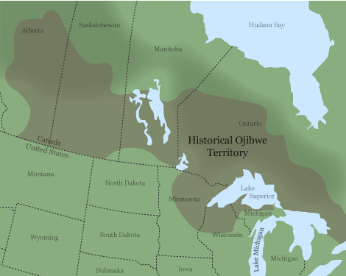
Traditional Territory
Great Lakes Homeland
Regional Naming Differences
Anishinaabe = larger cultural group
-Used in treaties and official records
-Ojibwe are one nation inside it
-Main focus will be the Great Lakes region
- Their own identity within Anishinaabe
Chippewa = government term
-Shaped Ojibwe travel, life, and settlement
Ojibwe spread across wide regions
Ojibwe = self same
Located around major Great Lakes
-Lake Superior, Lake Michigan, Lake Huron region
Forests, rivers, connected waterways
(Bishop)

Slide 3
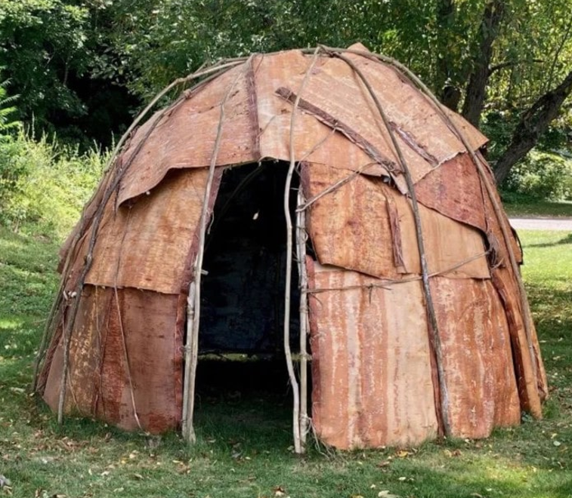
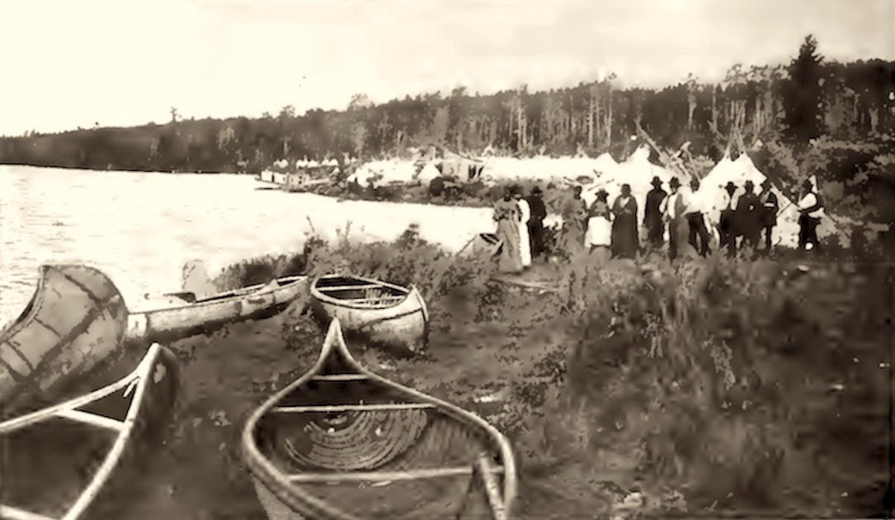
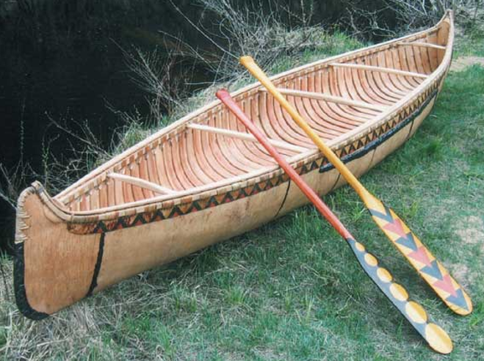
Life Style
Wigwams
Trade Networks
Copper
Birch Bark Canoes
Used for seasonal movements
Flexible dome shelters
Furs
Tools
-All traded across Great Lake routes
Light weight boats
Made from birch bark
Used for travel and trade
Made from birch bark
(“History and Culture of the Ojibwe/Chippewa Tribe”)
(Bishop)

Slide 4
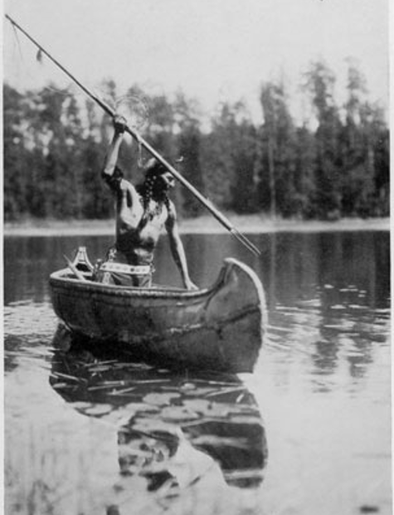
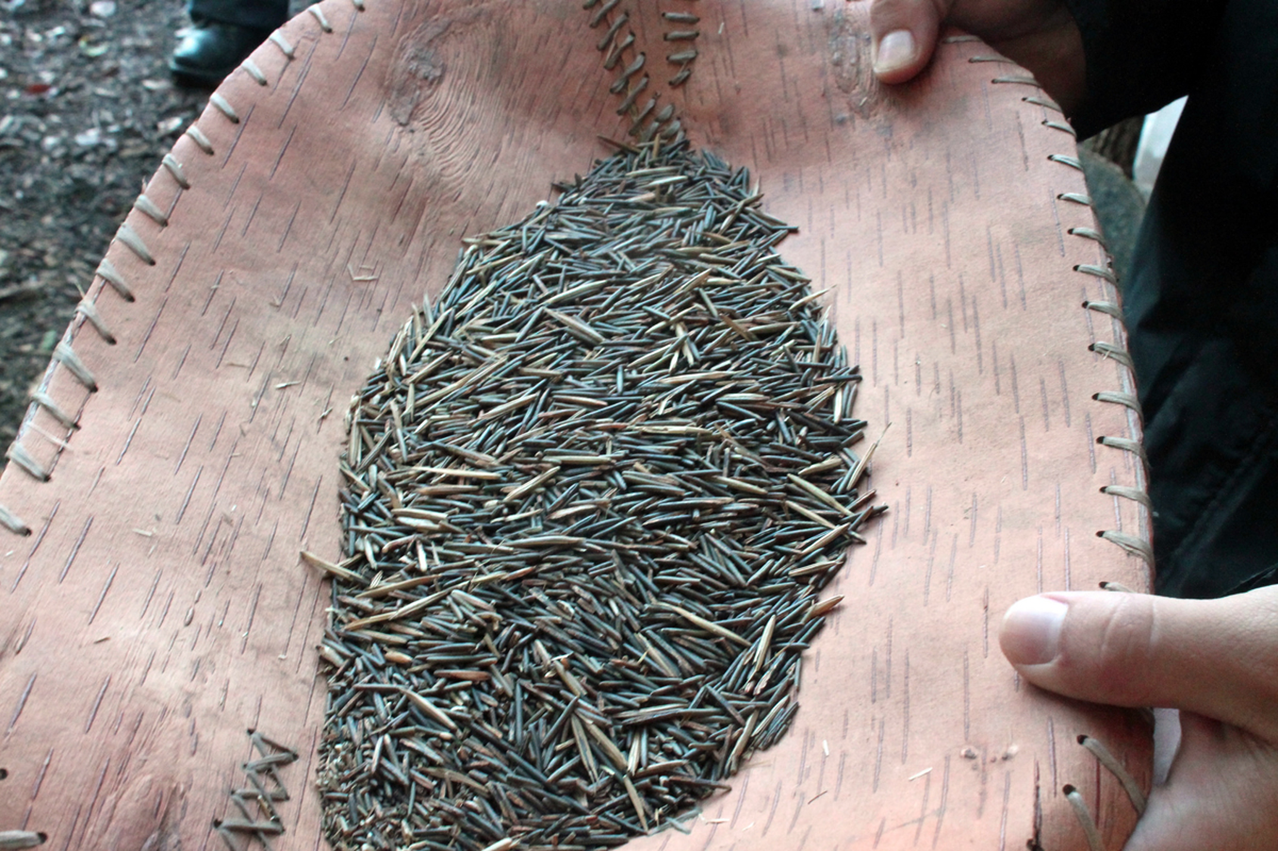
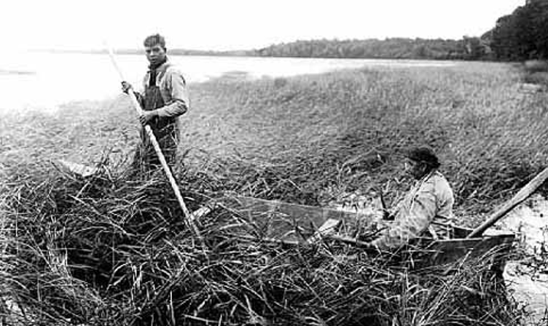
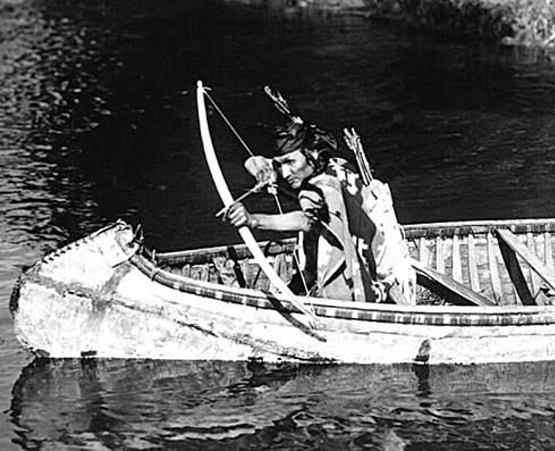
Food
Wild Rice/Manoomin
Fishing
Major food source in Great Lakes region
Hunting
Dried and parched for winter storage
Harvested in canoes
Types of fishes; trout, sturgeon, whitefish
Deer, moose, beaver, small game
Provided meat, hides, and tools
Gathering
Grows Naturally in Great Lake wetlands
They used nets, spears, traps
Berries e.g. blueberries and raspberries
Nuts and roots
Knocked into boat using wooden sticks
(“Ojibwa Food”)
(“History and Culture of the Ojibwe/Chippewa Tribe”)

Slide 5
Culture
Seven Grand Father Teaching
Language
Truth
Bravery
Bear Clan = protectors, healers
Anishinaabemowin
Love
Clan System
Respect
Wisdom
Humility
Generosity
Crane & Loon Clans = leadership, speakers
Fish Clan = teachers, knowledge keepers
Bird & Marten Clans = hunters, warriors
-spoken across Great Lakes region
Still taught in Great Lakes communities today
(“Gifts of the Seven Grandfathers”)
(Bishop)

Slide 6
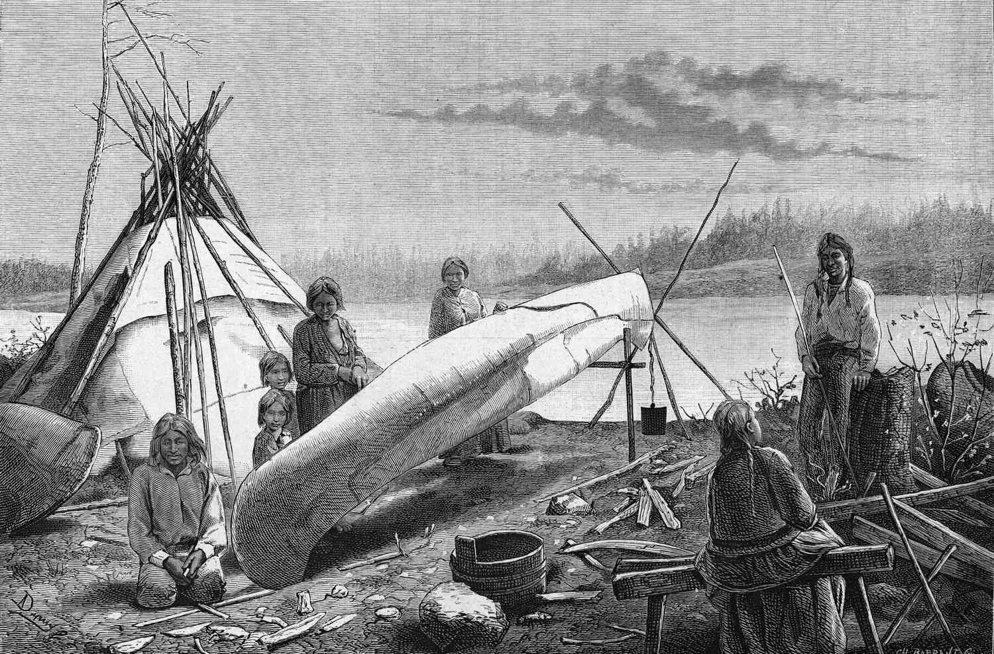
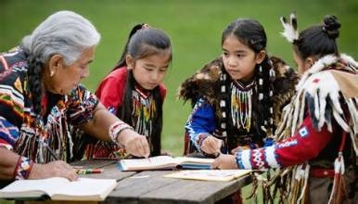
History & Modern
Fur Trade Alliances (1600s)
Protecting the Great Lakes environmental wetlands
Worked closely with French traders
Wild Rice/Manoomin Restorations
Community harvesting continues
Land Loss Through Treaties (1837-1855)
Cultural Revival
Exchanged fur, tool, and goods
Strengthened regional trade networks
Large areas of Great Lakes territory taken
Government controls increased
Communities/nations forced to relocate
Language classes and programs
Teachings shared by Elders
Cultural practices happening again
(Bishop)
(“History and Culture of the Ojibwe/Chippewa Tribe”)

Slide 7
Works Cited
Bishop, Charles A. “Ojibwa.” The Canadian Encyclopedia, Historica Canada, 7 Feb. 2006, https://thecanadianencyclopedia.ca/en/article/ojibwa, Accessed 7 Oct. 2026.
“Gifts of the Seven Grandfathers.” Ojibwe.net, https://ojibwe.net/projects/the-gifts-of-the-seven-grandfathers/, Accessed 7 Oct. 2026.
“History and Culture of the Ojibwe/Chippewa Tribe.” Native Hope, Native Hope, 30 Oct. 2022, https://blog.nativehope.org/history-and-culture-of-the-ojibwe-chippewa-tribe, Accessed 7 Oct. 2026.
“Ojibwa Food.” Native Art in Canada, Native Art in Canada, https://www.native-art-in-canada.com/ojibwafood.html, Accessed 7 Oct. 2026.

