Slide 1
Okanagan
By Callum Porter

Slide 2
Land acknowledgement
People live and work on the lands and waters of the syilx people, in the place called Vernon. People walk these mountains and explore these lakes, and people recognize that they are guests here. This land has been cared for by the syilx since time beyond memory, and their relationship to these waters and peaks continues today.
People commit to teaching and respecting this land, and to letting that respect shape how people move through it. People care for this place — not as something owned, but as something they are responsible to. People will learn from the land and from the syilx, and I will carry that learning into my work and my daily life here.
People hold this acknowledgement as a living practice, not just words.
Native-Land.ca | Our home on native land

Slide 3
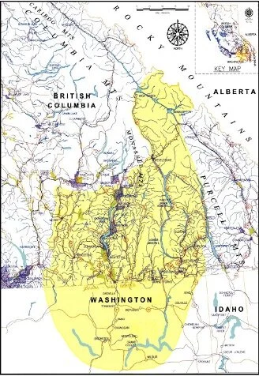
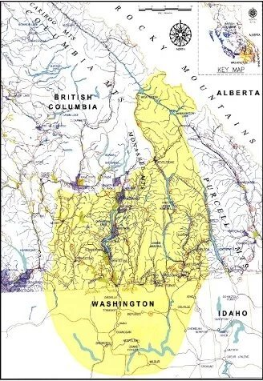
Syilx
The Syilx Okanagan People have occupied the Okanagan traditional territory since time immemorial. The Okanagan land base was approximately 43,000 square miles, situated in what is now known as south central British Columbia and north central Washington state. Syilx Okanagan society was marked by community cohesion and strong kinship ties, by cooperation, respect for community members and for the land.
Our Traditional Way of Life - Syilx 101
Image source:
Westbank First Nation

Slide 4
Pre contact

Slide 5
Westbank first nation
Certain areas of WFN Lands are traditionally known as stqaʔtkʷɬniwt which interprets to windy bay
Our people are suknaqínx, sqilxʷ, and/or syilx and our language is nqilxʷcn
WFN is one of eight communities that comprise the Okanagan Nation
Our traditional territory is roughly 69,000km²
WFN has over 900 Members, approximately 60% live on reserve
WFN is home to over 11,000 non-Member residents
WFN has five land parcels totaling 5,340 acres
                History & Territory - Westbank First Nation
No map given is a nation of the Sylix.

Slide 6
Okanagan People
The people of the Syilx were fishers, hunters, and gatherers.
The Syilx in the okanagan care a lot about the fish and they have a school program about how to hatch and raise fish
Our Traditional Way of Life - Syilx 101

Slide 7
culture
The syilx respect the land and the waters that they have.
The water is very important to the Syilx and is important to there history due to the aquatic systems that they are.
siwɬkʷ Water Declaration | Syilx Okanagan Nation
The forests of the Syilx are important because it gives the Syilx the principiles and standards of living.
SYILX FORESTRY PRINCIPLES AND STANDARDS | Syilx Okanagan Nation

Slide 8
Water acknowledgment
(77) siwɬkʷ Water Declaration - YouTube

Slide 9
Land knowledge
PRINCIPLE 1
Syilx rights, responsibilities, laws and protocols are recognized and upheld.
PRINCIPLE 2
Effective stewardship and restoration of ecosystems is demonstrated for 7 generations.
PRINCIPLE 3 siwɬkʷ—
Water is protected
PRINCIPLE 4
Ecological integrity and resilience are maintained and enhanced at the landscape level.
PRINCIPLE 5
Ecological integrity and resilience are maintained and enhanced at the stand level.
PRINCIPLE 6
Natural processes are maintained, enhanced, or restored.
PRINCIPLE 7
Healthy and resilient ecosystems foster community well-being.
PRINCIPLE 8
Collaborative processes and accountability are demonstrated.
PRINCIPLE 9
Syilx people receive a fair share of the economic benefits

Slide 10
Fisheries and wildlife
The Salmon in Syilx are very important.
The Syilx have hatcheries to help the salmon spawn because it is there main source of food
Fish in Schools (FinS) - Syilx 101
The Syilx people are also hunters.
The main program for hunting is tmix wildlife.
tmixʷ Wildlife | Syilx Okanagan Nation

