Slide 1
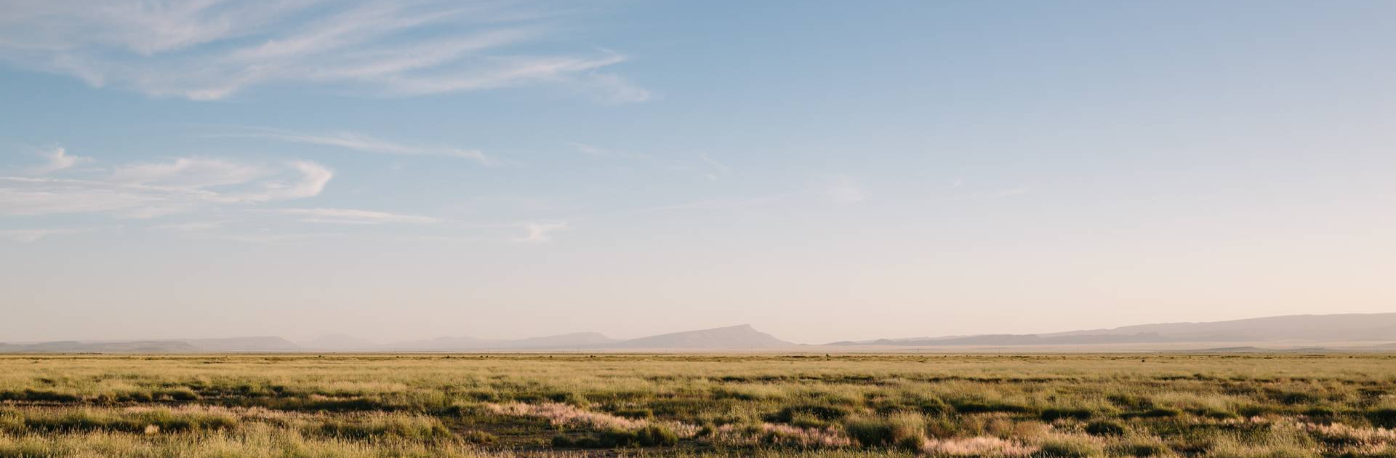
The Plains Cree
Presented by Ben & Elijah

Slide 2
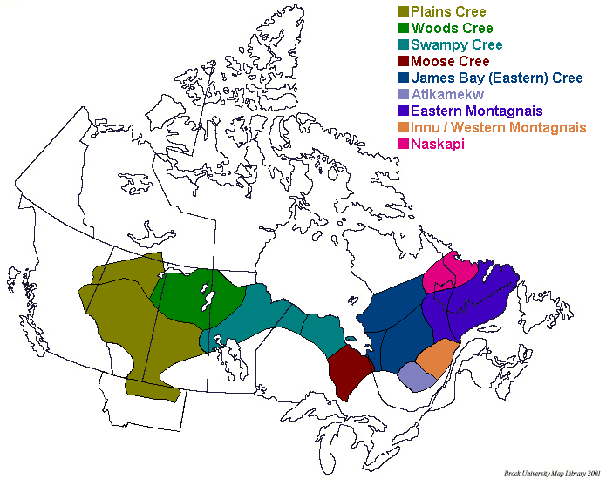
Traditional territory of the Plains Cree
The Plains Cree people's traditional territory

Slide 3
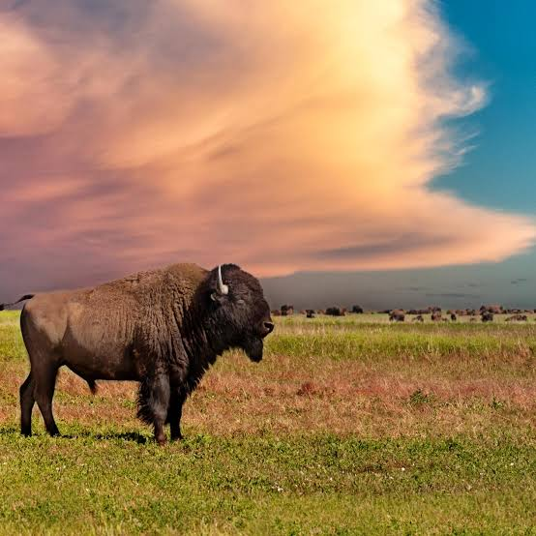
Lifestyle
-The Plains Cree used teepee’s
-Diet was mainly bison, wild game, fish, berries, and rice
-Trading fur
-The addition of horses helped hunt
-The Plains Cree also held feasts
-Were nomads

Slide 4
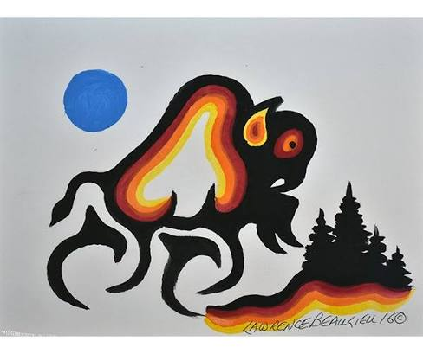
Culture
Beliefs - The Plains Cree spiritual beliefs
Family – they believe that family and relations go beyond biological parents and siblings to include all the community and creation
Organization - promote their heritage through dedicated cultural institutions, language projects, and community
Art – quillwork and functional crafts

Slide 5
History
The Plains Cree people migrated onto northern great plains
traditional economy focused on bison hunting and gathering wild plant foods. After acquiring horses and firearms, they were a more military based group
divided into 12 independent bands

Slide 6
Citation’s
Pass The Feather. “Cree Archives - Indigenous Arts Collective.”
Indigenous Arts Collective, indigenousartscollective.org/tag/cree.
Wikipedia contributors. “Cree.” Wikipedia, 3 Oct. 2026, en.wikipedia.org/wiki/Cree.
Wikipedia contributors. “Cree.” Wikipedia, 3 Oct. 2026, en.wikipedia.org/wiki/Cree.

