Slide 1
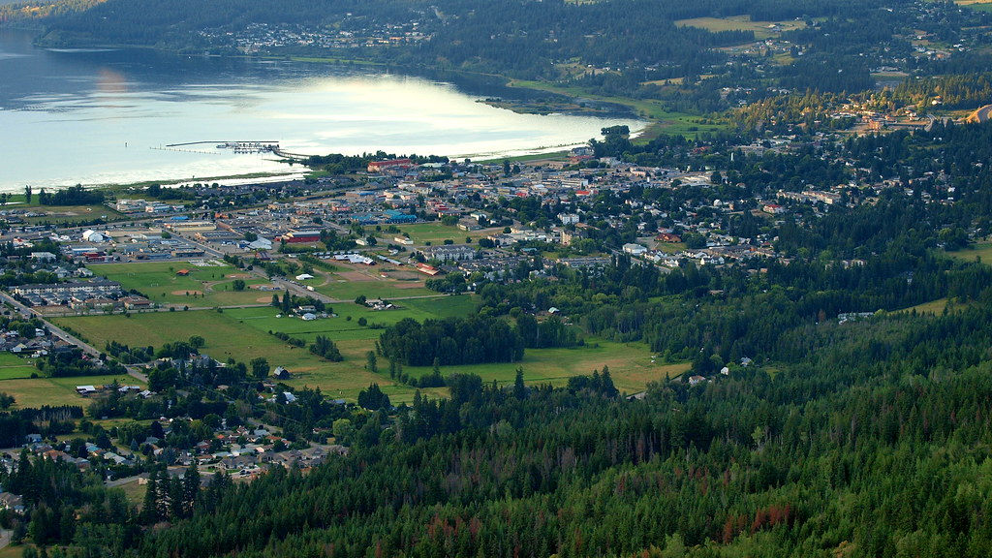
Shuswap Indigenous Group (Plateau)
By Rylee Higgs and Conner Sandhu
This Photo by Unknown Author is licensed under CC BY-NC-ND

Slide 2
Who are the Shuswap?
The Shuswap or otherwise known as the Secwepemc

Slide 3
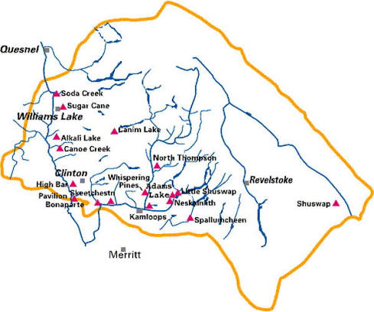
Traditional Territory
The Shuswap territory is in the southeast corner of B.C. and is the second smallest region in the province.
Some known places that the are in Shuswap territory are Kamloops, Kelowna, Banff, and Calgary.

Slide 4

Shuswap Lifestyle
The Shuswap Band lives in Pithouses during the winter. In the summer they live in tipi-styled mat lodges for houses
The Shuswap Band food depends on the season. In Winter, their diet relies mostly on fish (Fresh or salt water). During summer they have more options like hunting deer, elk, moose and caribou.
For the trade the Shuswap uses major networks through the mountains such as Howse Pass, Eagle Pass, and Blaeberry River System. Trading outbounds (out of territory) they would trade for salmon, salmon oils, Alpine and Mountain Medicine, Orche, and Deer Skin. For the inbound trades they would trade for bison (allow Alberta Nations), horses, and shells.
This Photo by Unknown Author is licensed under CC BY-SA

Slide 6
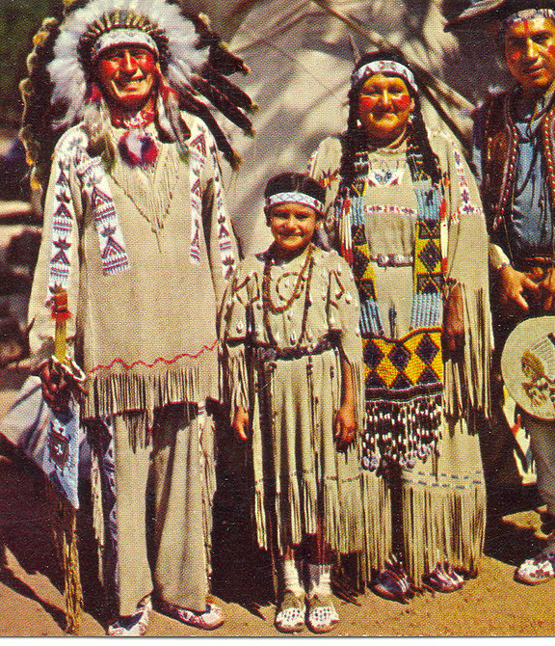
Culture
Spiritual beliefs
Family/community organization
Art
This Photo by Unknown Author is licensed under CC BY-NC-ND

Slide 7

Citations (Our Sources)
“The Pit House: Indigenous Architectural Innovation.” Indigenous Tourism BC, 28 May 2025, www.indigenousbc.com/stories/the-pit-house/. Accessed 6 Oct. 2026.
“Seasonal Rounds.” Shuswap Band, 2026, www.shuswapband.net/seasonal-rounds/. Accessed 7 Oct. 2026.
De Brabandere, Olivia. Quoted in “Historical Trade Routes Evolving for SIB.” The Columbia Valley Pioneer, 27 Aug. 2020, www.columbiavalleypioneer.com/historical-trade-routes-evolving-for-sib/. Accessed 7 Oct. 2026.
“Territory & Caretaker Area.” Shuswap Band, 2026, www.shuswapband.net/territory-caretaker-area/. Accessed 7 Oct. 2026.
Hi
Hi
Hi
Hi
Hi

