Slide 1


Bill & Ted’s Excellent Adventure
How a bill becomes law
SS11 Government
’s

Slide 2
What is a bill
A Bill is a draft law that Parliament proposes to make
Can be proposed by any MP or Senator.

Slide 3
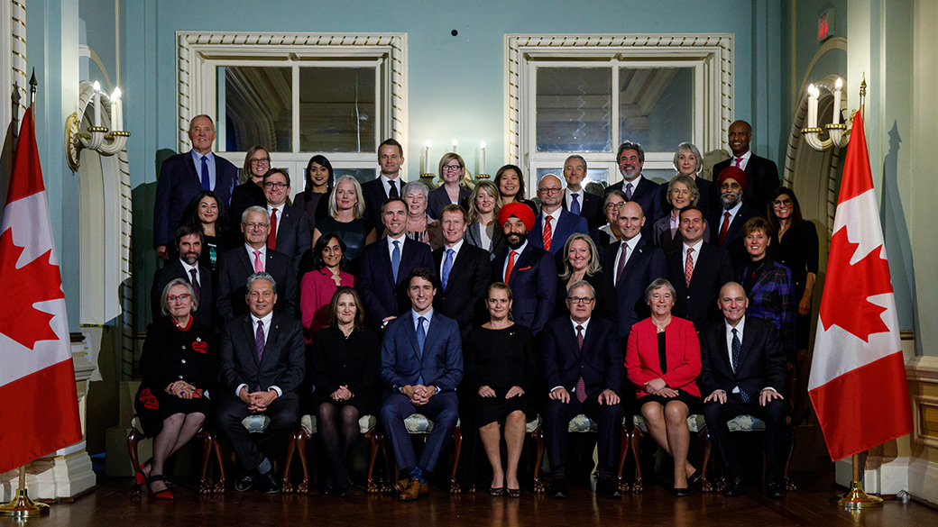


Step 1: Introduction of Bill
Idea is proposed to cabinet
  Send idea to Lawyers to write bill
Cabinet and Caucus
  review bill
  If approved send to the House of Commons

Slide 4
Step 1 cont:
First Reading – bill is presented to public – printed – given a name
C-# for House of Commons bill (i.e. Bill C-17)
S-# for Senate bill

Slide 5
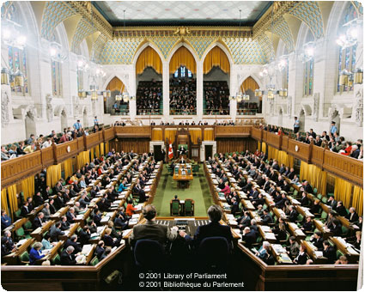
STEP 2:
Second Reading:
  Bill is debated in HofC
    Changes suggested
Committee Stage
  Bill is reviewed line by line
  Changes may be made in this stage
Third Reading
  Final debate
  Bill is voted on (if passed moves to next stage)

Slide 6
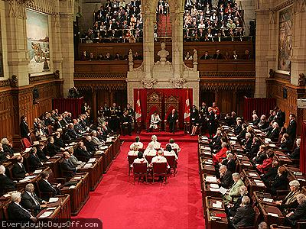


Step 3
Senate
  The process starts again from first reading
If the same bill passes both HofC and Senate
  Governor General give Royal Assent
  Bill is signed
  Becomes a law
    Effective immediately

