Slide 1
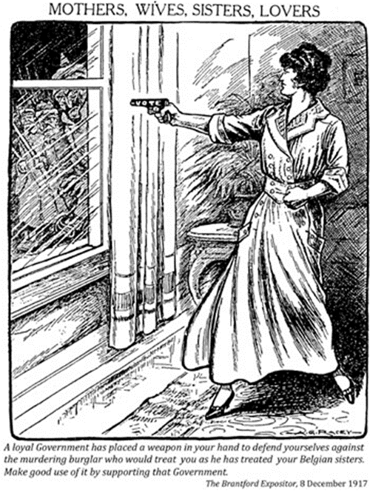
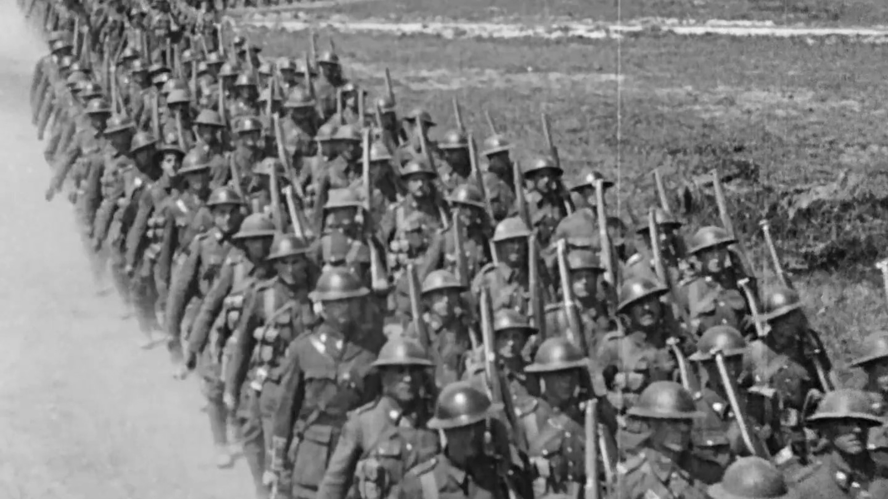
WWI in Canada

Slide 2
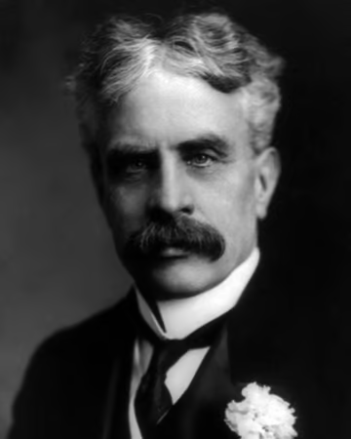

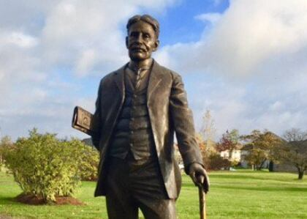
Canada’s Leadership in 1914
-The Prime Minister of Canada during World War I was Robert Borden and he represented the Conservative Party.
-He believed in Imperial Solidarity or following Britain’s Example.

Slide 3
The War Measures Act
-The War Measures Act was passed in August of 1914 and gave the Canadian government additional Powers during times of war including:
  -The control and suppression of publications.
  -More power to arrest and detain.
  -Full control of all harbours and ports.
  -Control and the ability to forfeit property.

Slide 4
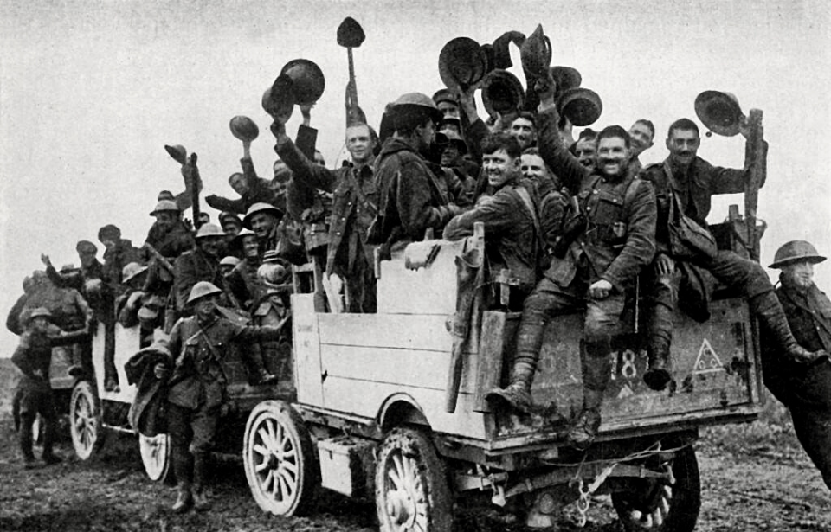
Who was allowed to be a Soldier?
-Men.
-Had to be at least 5’ 3”.
-18-45 years of age.
-Had to be in good Health.
-Visible Minorities rejected (at first).

Slide 5
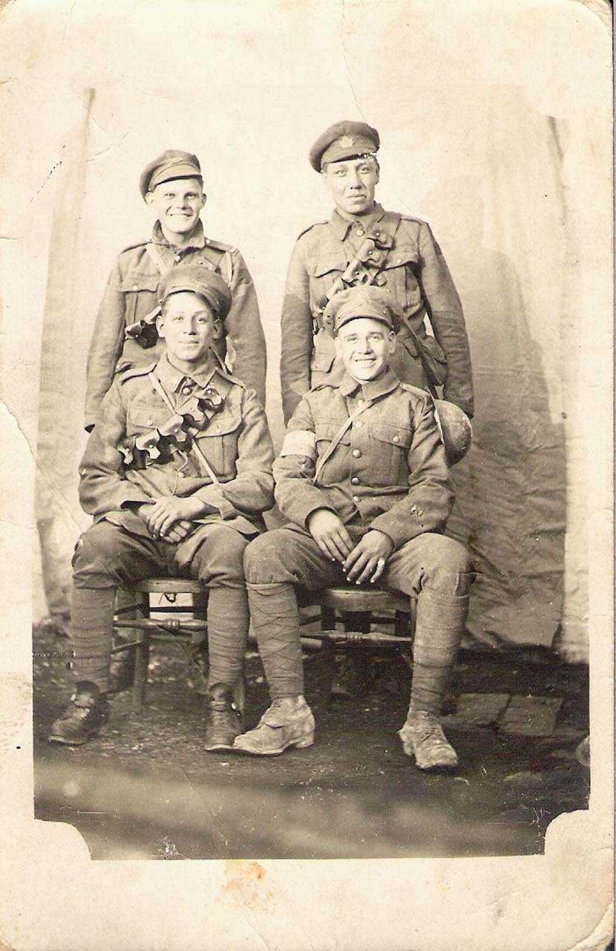
Indigenous Peoples in WWI
-Initial recruitment was low as Indigenous peoples thought that the Germans would not, “…extend to them the privileges of civilized warfare.”
-After 1915, Britain encouraged colonies to recruit Indigenous soldiers.
-First Nations integrated into existing units, not allowed “all-Indian” units.
-This led to mutual respect and comradery in the trenches.
-Indigenous soldiers found success as scouts and snipers thanks to their extensive hunting knowledge.

Slide 6
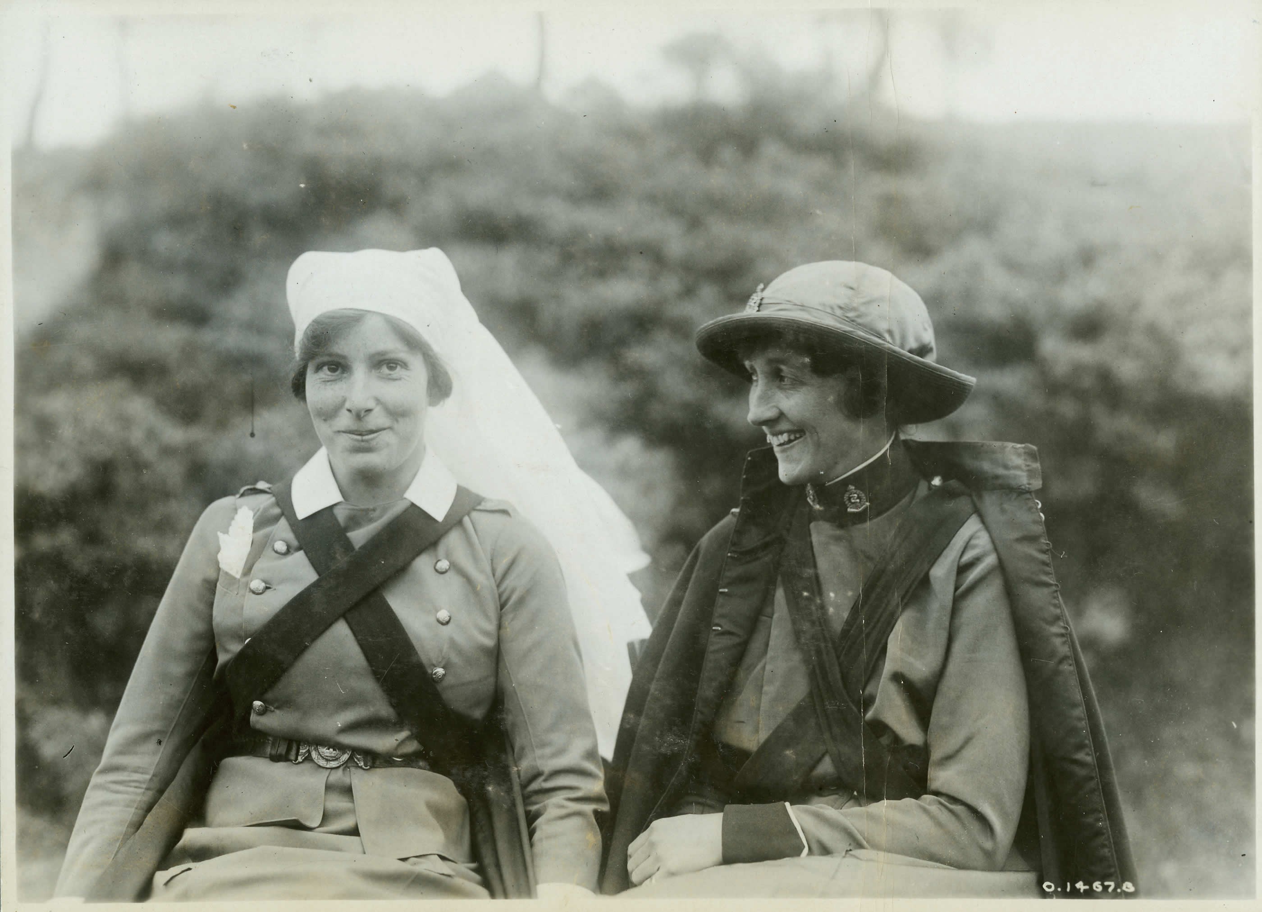
Roles for Canadian Women in Europe
-Women could not be Soldiers, but…
-Nurses and Doctors for treating wounded on the front lines or treating disease such as Influenza or Typhoid.
-Drivers for ambulances or delivery trucks.
-Mechanics to repair all the vehicles used in war.

Slide 7
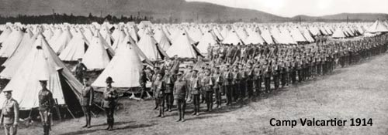
How did Canada Mobilize?
-Canada’s standing army before WWI was only 3110 men strong.
-Canada started to open training camps like Camp Valcartier (Quebec) and Camp Hughes (Manitoba).
-Camp Valcartier held over 35 000 soldiers.
-Camp Hughes held over 25 000 soldiers.

Slide 8
How did Canada Arm its Soldiers?
-The British had to stop selling their gear to Canada due to their sudden mobilization.
-Canada started to produce its own gear rather than buy from the Americans.
-Unfortunately, this led to rampant War Profiteering (unreasonably high profits on war-related items).
-One example of this was Canadian troops’ boots dissolving in the wet trench conditions due to the soles being made of cardboard.

Slide 9
The Ross Rifle
-Canadian Sir Charles Ross sought to create a rifle of higher quality than the British standard Lee Enfield Rifle.
-The Ross Rifle became the standard Canadian weapon of WWI.
-Unfortunately, the Ross Rifle jammed incredibly easily and did not hold up to the rigors of trench warfare (mud, blood, and constant flooding).
-This led to many Canadians abandoning their Ross Rifles in favour of whatever else they could scavenge.

Slide 10
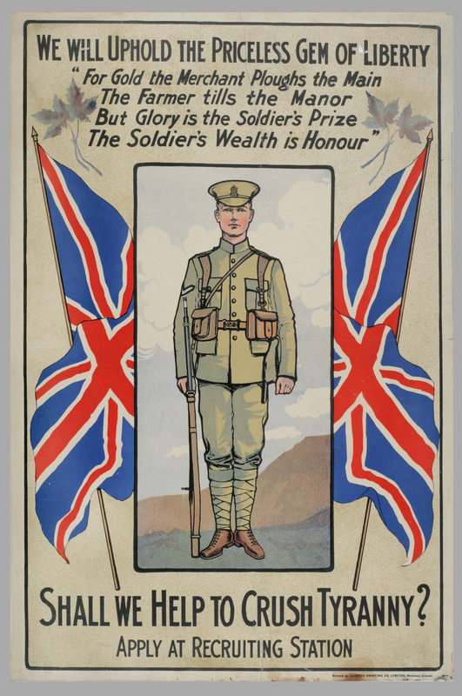
Who Supported the War?
-Broadly speaking, Canadians of British descent felt it
was their duty to help the empire.
-French Canadians felt that they did not owe anything
to Britain.
-Many also felt their ties with France were weak.

Slide 11
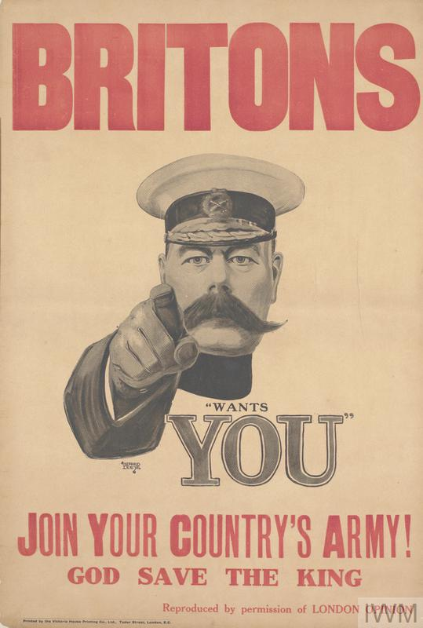
Propaganda Posters
-Propaganda is information that is meant to shape people’s thinking.
-Always carries a message and a bias.
-Propaganda posters are a common sight in wartime.
-Almost always to support a war.

Slide 12
Political Cartoons
-Similar to propaganda posters.
-Usually made in response to an event in a way that critiques or mocks.
-Similar to how some memes are used today.

Slide 13
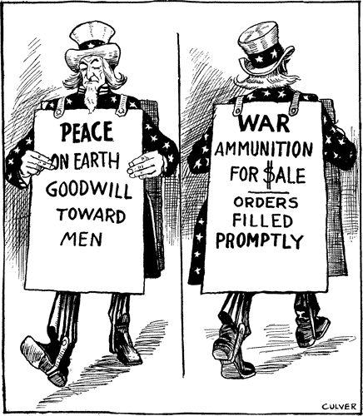
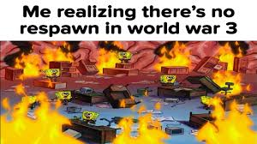
WWI Political Cartoon
WWIII Meme

Slide 14
Political Cartoon and Propaganda Analysis
Instructions:
  Form a group of up to 3 people (move around to regroup so everyone can see).
  When ready, put up a hand to receive your political cartoon and piece of propaganda.
  Fill out the questions on the group sheet together, everyone should have some input.
  When finished, wait until we share out.
  After share outs, hand in the group worksheet and return propaganda and political cartoons to the teacher desk.

Slide 15
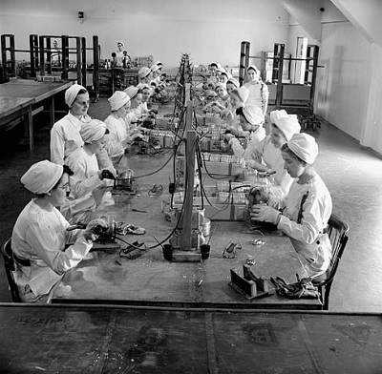
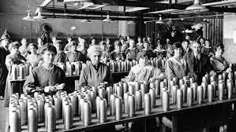
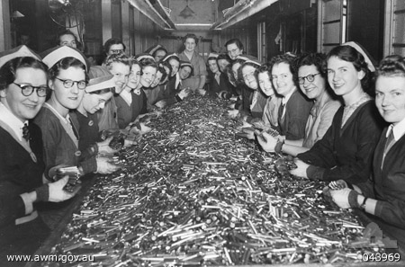
Women in Canada
-With men gone to Europe, women had to fill traditionally male-dominated jobs.
-About 35,000 women worked in munitions factories in Ontario and Quebec.
-Munitions are military weapons, ammunition, and equipment.

Slide 16
Women in Canada cont.
-Women also did a lot in their spare time.
-They produced and carefully rationed food to help with shortages that were rampant during the course of the war.
-Women also headed a lot of charity work to raise money for hospitals, ambulances, aircraft, and more.

Slide 17
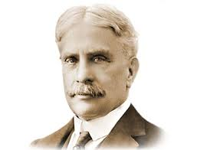
Robert Borden’s Acts
-Robert Borden had implemented the War Measures Act in 1914 to give the government more power during times of war.
-But he also passed two more acts due to the war…

Slide 18
The Military Service Act
-The Military Service Act was passed in 1917 to make conscription enforceable by law.
-Conscription is when citizens must answer the call to go to war if under certain conditions.
-These conditions were similar to what soldiers they would accept, such as being between 18 and 45.
-This was a fairly unpopular idea.

Slide 19
Conscription
-Canada had already sent over 300,000 soldiers overseas by 1917.
-However, willing volunteers had stopped coming in by 1917.
-Women largely supported the act because it was their husbands and sons fighting and they wanted to send further support for them.
-Most British Canadians also wanted to send more support.

Slide 20
Conscription cont.
-The main detractors of conscription were farmers, who did not want their sons taken away from them, and French Canadians, who did not want to fight for Britain.
-Indigenous People were not forced into conscription because they were not allowed to vote and could not help decide on conscription.

Slide 21
The Military Voters Act
-The Military Voters Act was passed in 1917 and gave the vote to soldiers overseas and to female relatives of these soldiers.
-This included Indigenous soldiers who could not vote in Canada.
-This act also took the vote away from enemy aliens.
-Enemy aliens are Canadian residents from countries Canada was warring with.

Slide 22
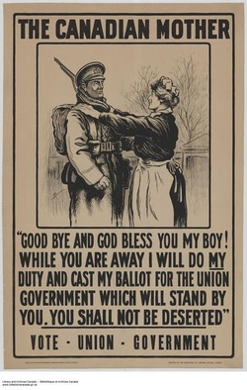
The Military Voters Act cont.
-While this Act granted many the right to vote for the first time, it is contentious due to it being seen as a way to gather support for Prime Minister Robert Borden.
-It also established many Anti-Immigrant sentiments.

Slide 23
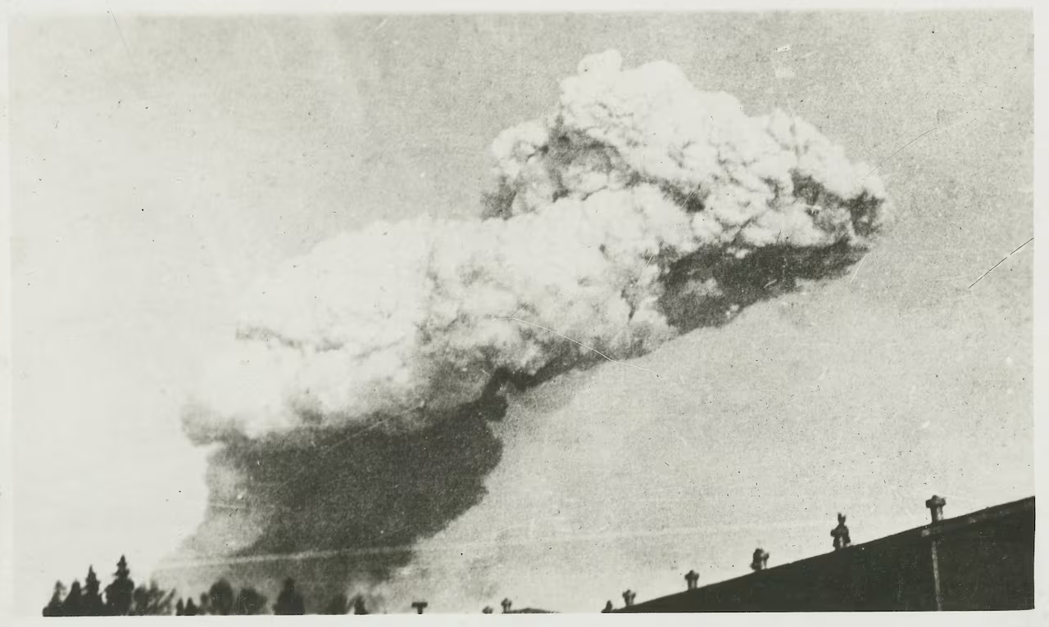
The Halifax Explosion
-On December 6th 1917, The Imo, a Belgian relief ship collided with a French ship, the Mont Blanc.
-The Mont Blanc was transporting a large cargo of explosives.
-The ship exploded!

Slide 24
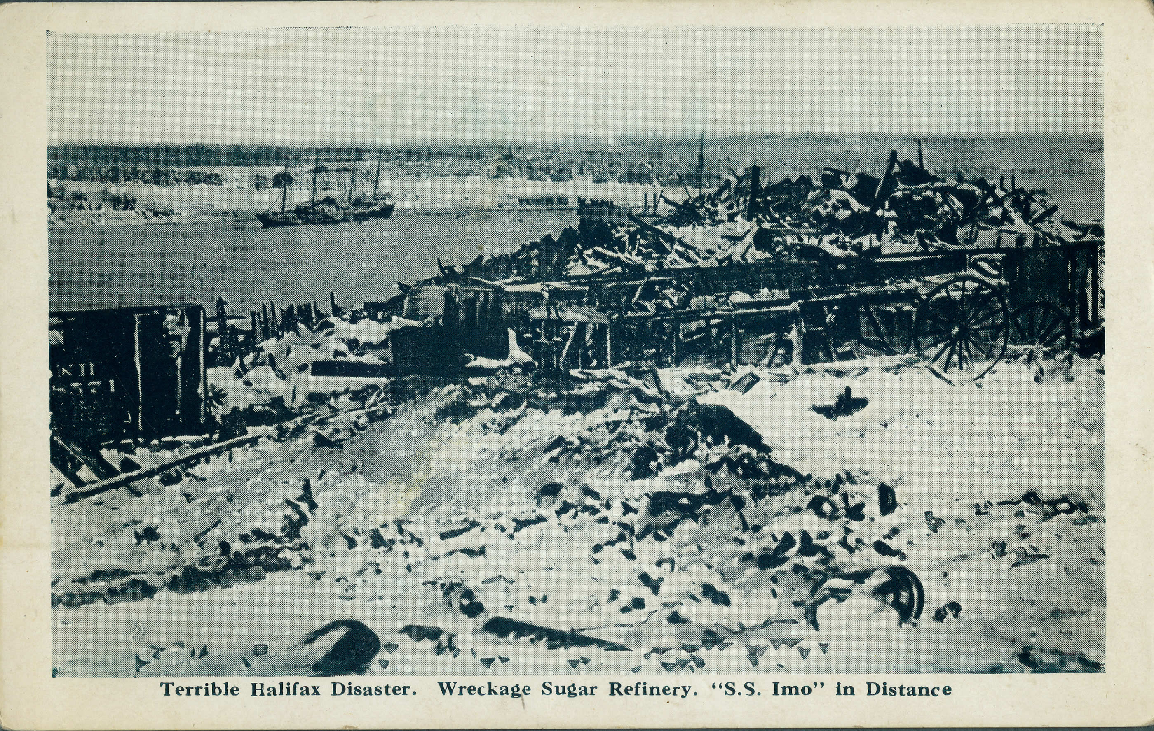
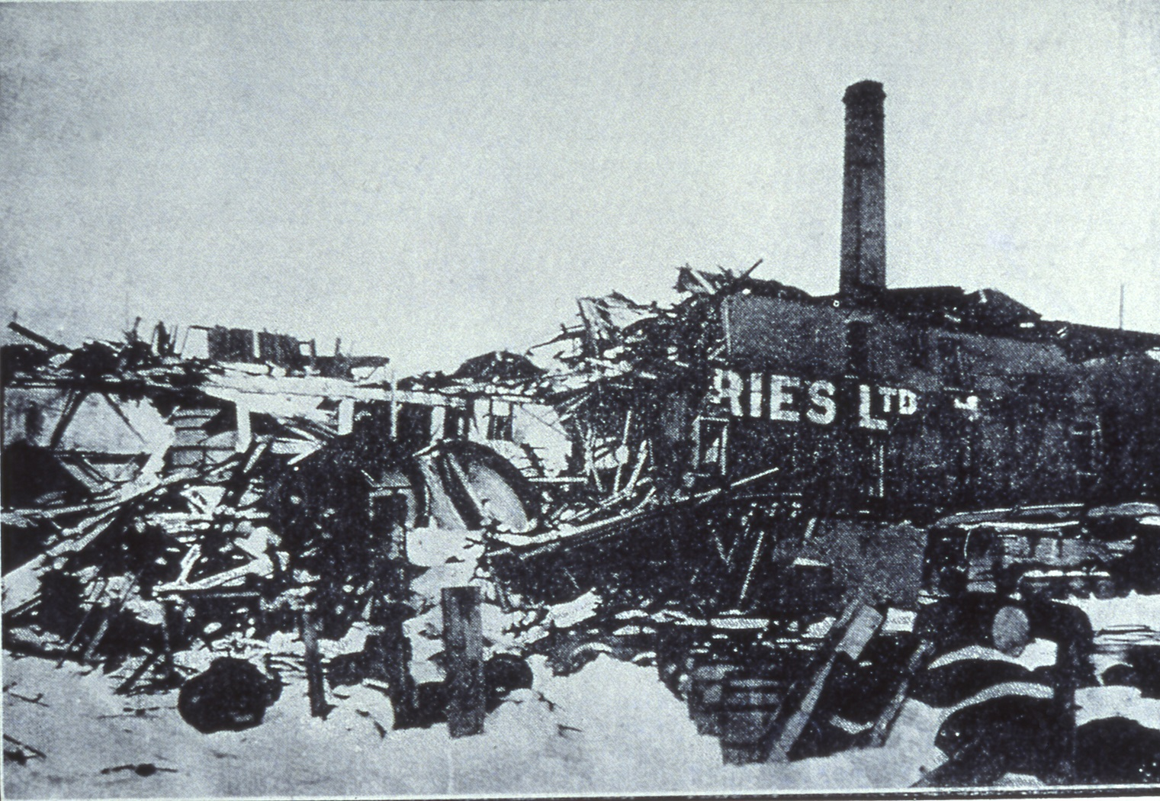
The Halifax Explosion cont.
-The surrounding areas were ravaged with over 2000 killed and 9000 injured.
-This created the largest man-made explosion ever created until the use of the atomic bomb during World War II.

Slide 25
Timeline of the Halifax Explosion
https://www.youtube.com/watch?v=JKcXSCzcSZ4

